Slide 1

STUDENT NAME : DURGADEVI I REGISTER NO AND NMID : 24131210500122015 nmid : anasanm121anm12124213015 DEPARTMENT : BCA COLLEGE : IMMCULTE COLLEGE FOR WOMEN UNIVERSITY : ANNAMALAI UNIVERSITY

Slide 2
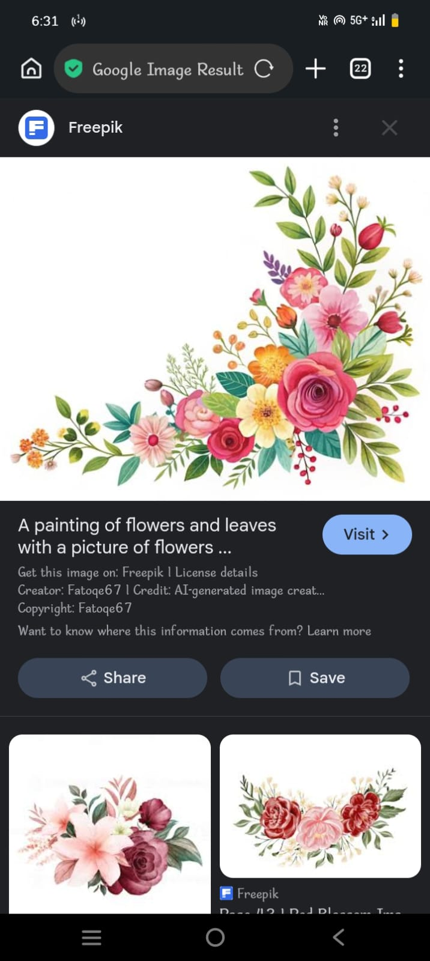
PROJECT TITLE !!!
SMART STUDENT PORTFOLIO SYSTEM

Slide 3


AGENDA !!!
PROBLAM STATEMENT
POJECT OVERVIEW
END USERS
TOOLS AND TECHNOLOIES
POTFOLOI DESIGN AND LAYOUT
FEATURES AND FUNCTIONALITY
RESULT AND SCREENSHOTS
CONCLUSION
GITHUB LINK

Slide 4


PROGRAM STATEMENT !!!
*Problem Statement*: Student projects find it hard to showcase skills.
Traditional CVs or plain documents are not interactive
Portfolio websites using web technologies solve this problem.

Slide 5

PROJECT OVERVIEW !!!
THIS PROJECT AIMS TO DEVELOP AN INTERCTIVE STUDENT PORTFOLIO WEBSITE USINF HTML,CSS,AND JAVASCRIPT.
THE WEBSITE IS DESIGNED TO BE REPONSIVE,ATTRACTIVE,EASY TO NAVGATE,ENABLING STUDENT TO SHOWCASE THEIR PERSONL PROFILE,ACADEMIC BACKGROUND,SKILL,ACHIVEMENTS,ND PROJECTS EFFECTIVELY.
THE PORTFOLIO SERVES AS A DIGITAL
RESUME AND PERSONAL BRANDING TOOL
ALLOWING STUDENT TO STAND OUT IN
COMPETITIVE ENVIRONMRNTS SUCH AS
JOB INTERVIEWS ,
INTERNSHIPS,,
ACADEMIC APPLICATIONS ////

Slide 6
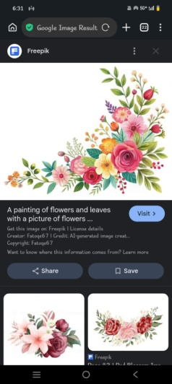
END USERS !!!
STUDENT
SKILL
UNIVERSITIES
FOR ADMISSION
PROJECT EVALUATIONS
COLLABORATORS
DEVELOPERS
PEERS LOOKING FOR POTENTIALK TEAMWORK
PROJECT
TO SHOWCASE THEIR PROFIL
SCHOLRSIP
DESINERS
TO
EVALUATE
A STUDENT
TECHNICL
BILITIES
AND PAST
WORK
EMPLOYERS

Slide 7

TOOLS AND TECHNOLOGIES !!!
CATEORY TOOLS // TECHNOLOIES FORNTENT HTML5, CSS3, JAVASCRIPT .
DESIGN FIGM // CNV (OPTIONAL) VERSION CONTROL GIT, GITHUB CODE EDITOR VS CODE RESPONSIVE DESIGN C FLEXBOX, CSS GRID,MEDIA QUERIES .
DEPLOYMENT GITHUB PAGES // NETLIFY.

Slide 8


PORTFOLIO DESIGN AND LAYOUT !!!
HOME PAGE STUDENT INTRODUCTION, PROFILE
PICTURE,TAGLINE.
ABOUT ME PERSONL INFORMTION EDUCATION
BACKGROUND .
SKILL LIST OF TECHNICAL AND SOFT SKILL.
PROJECT INTERCTIVE CRDS SHOWCASIN PROJECT
TITLES DESCRIPTIONS , LIVE / DEMO LIKES.
ACHIVEMENTS CERTIFICATES , AWARDSN , MILESTONES
CONTACT SECTION EMAIL,PHONE, SOCIAL MEDIA LINKS

Slide 9

LAYOUT FEATURES !!!
HEADER ~
>>> SMOOTH SCROLLING TO SECTIONS .
RESPONSIVE GRID~
>>> OPTIMIZED FOR DESKTOPS ,TBLETS ,MOBILE.
COLORE PALETTE~
>>> CLEAN,MODERN PROFESSIONAL.
TYPOGRAPHY ~
>>> READABLE AND MINIMLISTI FONT STYLING.

Slide 10

FETURES AND FUNCTIONALITY !!!
RESPONSIVE DESIGN :
WORK SEAMLESSLYN ON ALL
DEVICES.
INTERCTIVE NAVIGATION :
SMOOTH SCROLLING AND MENU
HIGHLIHTS.
PROJECT SHOWCASE :
DISPLAY S COMPLETED PROJECTS
WITH LIVE DEMO LIKES.
SKILL BADGES :
VISUAL REPRESENTATION OF
TECHNICAL PROFICIENCY.
CONTACT FROM :
USERS CAN REACH OUT
DIRECTLY.
SOCIAL MEDIA
INTEGRATION :
LINKS TO LINKEDIN , GITHUB
AND OTHER PROFILES.

Slide 11
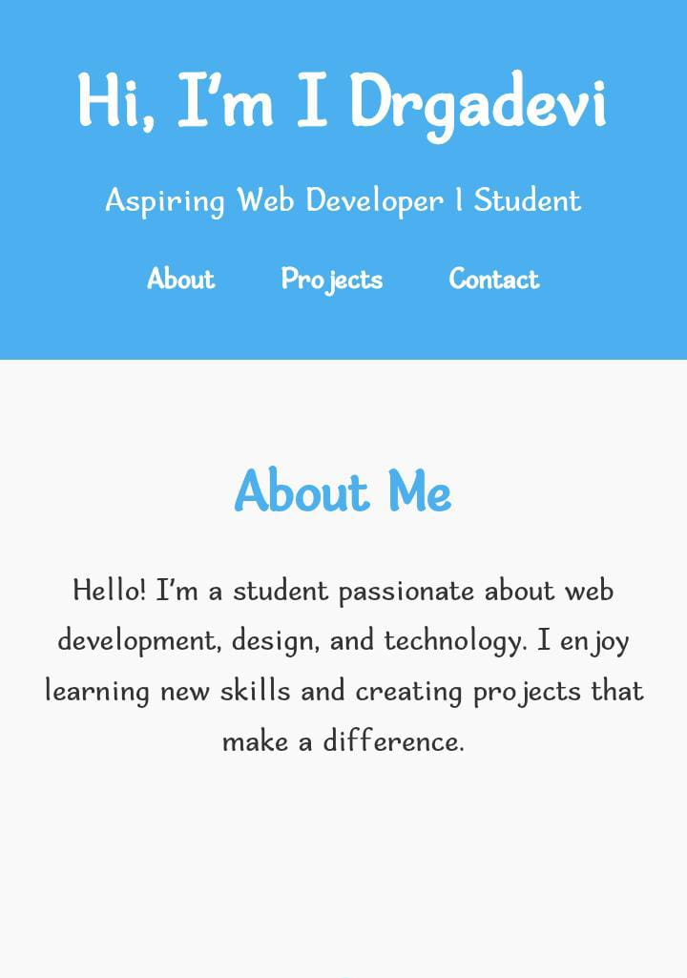
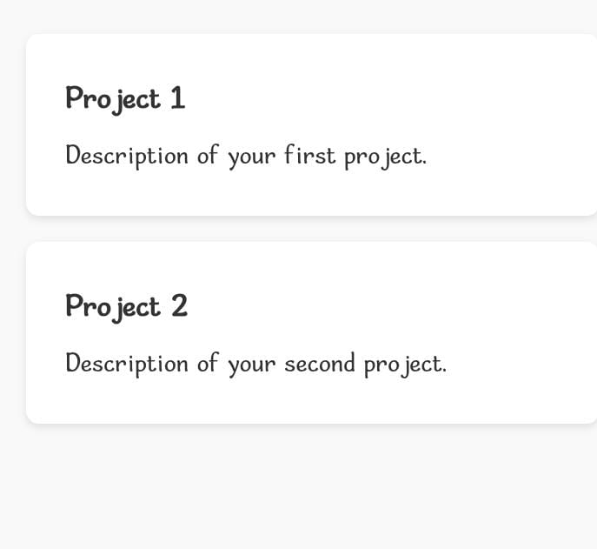
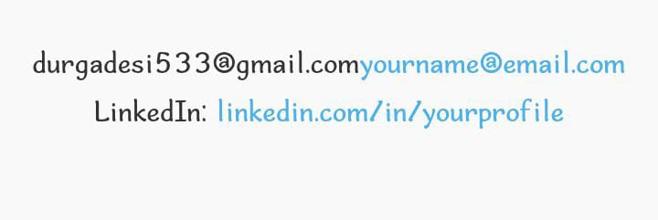
RESULTS AND SCREENSHOTS !!!

Slide 12

CONCLUSION !!!
Portfolio effectively showcases skills and projects.
Enhance online presence for job/ freelancing.
HTML, CSS, JAVASCRIPT. Provide complete interactive web experience.

Slide 13
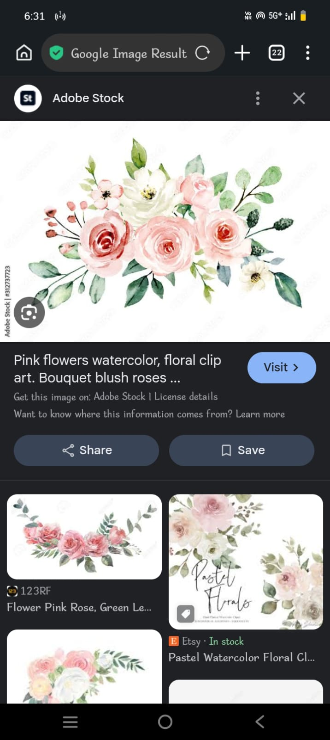
GITHUB !!!
CLICK HERE TO VIEW PROJECT ON GITHUB.
(REPLACE “ # “ WITH YOUR REPOSITORY LINK ONCE UPLODED )
https://github.com/durgadesi533-netizen/Projects-TNSDC-FWD-DPlP.git

